Slide 1
The Array Data Structure
Properties of arrays and partially-filled arrays
Array algorithms

Slide 2
Properties of arrays in general
An array is a sequence of indexed components.
Each array component has a fixed and unique index. The indices range from a lower bound to an upper bound:
low
low+1
low+2
high–2
high–1
high
indices
a
components
The length of the array (its number of components) is fixed when the array is constructed.

Slide 3
Properties of arrays in general (ctd)
Any array component can be efficiently accessed (inspected or updated) using its index, in constant time
Elements of an array are directly accessible
the position of each element can be computed from its index by a mathematical formula
For example, an array of 10 integer variables, with indices 0 through 9, may be stored at memory addresses 2000, 2001, 2002, … 2009, so that the element with index i has the address 2000 + i

Slide 4
Properties of arrays in Java
A Java array’s components are either values of some stated primitive type, or objects of some stated class.
A Java array of length n has lower bound 0 and upper bound n–1.
A Java array is itself an object. It is allocated dynamically by “new T[n]”.
class tag
length
0
1
n–2
n–1
a
T[]
n
components

Slide 5
Example: Java primitive array
Code to create, initialize, and inspect an array of integers:
int[] primes = {2, 3, 5, 7, 11, 13}; for (int i = 0; i < primes.length; i++) System.out.println(primes[i]);
primes
class tag
length
0
1
2
3
4
5
int[]
6
2
3
5
7
11
13

Slide 6
Example: Java object array (1)
Suppose that a Date object has fields y, m, d.
Code to create an array of Date objects:
Date[] hols = new Date[3];
class tag
length
0
1
2
hols
Date[]
3
Notes:
Can assign another reference to the array
e.g. Dates dates = hols;
Then both variables reference the same array

Slide 7
Example: Java object array (2)
Code to update the array of Date objects:
hols[0] = new Date(2002, 1, 1); hols[1] = new Date(2001, 5, 1); hols[2] = new Date(2001, 12, 25);
class tag
length
0
1
2
hols
Date[]
3
class tag
y
m
d
Date
2001
12
25
class tag
y
m
d
Date
2001
5
1
class tag
y
m
d
Date
2002
1
1

Slide 8
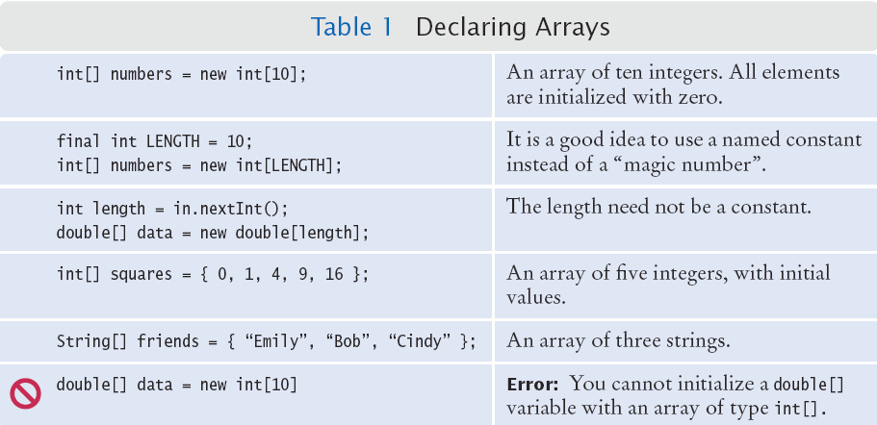

Slide 9
Partially-Filled Arrays
An array cannot change size at run time
The programmer may need to guess at the maximum number of elements required
It is a good idea to use a constant for the size chosen
Use a variable to track how many elements are filled
final int LENGTH = 100;
double[] values = new double[LENGTH];
int currentSize = 0;
Scanner in = new Scanner(System.in);
while (in.hasNextDouble())
{
if (currentSize < values.length)
{
values[currentSize] = in.nextDouble();
currentSize++;
}
}
Maintain the number of elements filled using a variable (currentSize in this example)
Copyright © 2013 by John Wiley & Sons. All rights reserved.
Page 9

Slide 10
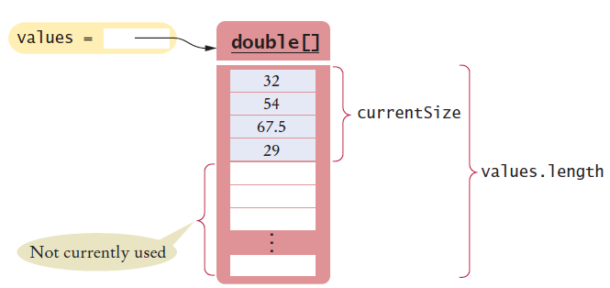
Walking a Partially Filled Array
Use currentSize, not values.length for the last element
for (int i = 0; i < currentSize; i++)
{
System.out.println(values[i]);
}
A for loop is a natural choice to walk through an array
Copyright © 2013 by John Wiley & Sons. All rights reserved.
Page 10

Slide 11
Common Array Algorithms
Filling an Array
Sum and Average Values
Find the Maximum or Minimum
Removing an Element
Inserting an Element
Swapping Elements
Copyright © 2013 by John Wiley & Sons. All rights reserved.
Page 11

Slide 12
Common Algorithms 1 and 2:
1) Filling an Array
Initialize an array to a set of calculated values
Example: Fill an array with squares of 0 through 10
2) Sum and Average
Use enhanced for loop, and make sure not to divide by zero
int[] values = new int[11];
for (int i = 0; i < values.length; i++)
{
values[i] = i * i;
}
double total = 0, average = 0;
for (double element : values)
{
total = total + element;
}
if (values.length > 0)
{ average = total / values.length; }
Copyright © 2013 by John Wiley & Sons. All rights reserved.
Page 12

Slide 13
Common Algorithms 3:
Finding the maximum element in an array:
write pseudocode for this
Likewise for the minimum
Copyright © 2013 by John Wiley & Sons. All rights reserved.
Page 13

Slide 14
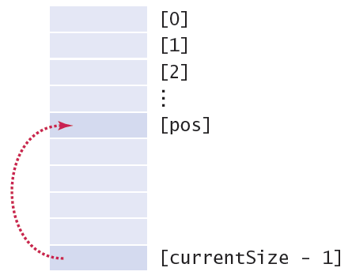
Common Algorithms 4a:
Removing an element (at a given position, pos)
Requires tracking the ‘current size’ (# of valid elements)
But don’t leave a ‘hole’ in the array!
Solution depends on if you have to maintain ‘order’
If not, find the last valid element, copy over position, update size
validate pos
values[pos] = values[currentSize – 1];
currentSize--;
Copyright © 2013 by John Wiley & Sons. All rights reserved.
Page 14
Notes:
How to implement «validate pos» ?
Answer: throw an exception
See Exception Handling Slides, in particular slide 2.

Slide 15
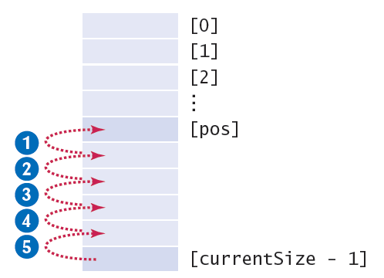
Common Algorithms 4b:
Removing an element and maintaining order
Requires tracking the ‘current size’ (# of valid elements)
But don’t leave a ‘hole’ in the array!
Solution depends on if you have to maintain ‘order’
If so, move all of the valid elements after ‘pos’ up one spot, update size
validate pos
FOR i from pos+1 to currentSize-1
move values[i] up one slot
ENDFOR
DECREMENT currentSize
Copyright © 2013 by John Wiley & Sons. All rights reserved.
Page 15
Notes:
if (pos >= 0 and pos <= currentSize-1) {
for (int i = pos+1; i <= currentSize - 1; i++)
{
values[i-1] = values[i];
}
currentSize--;
}

Slide 16
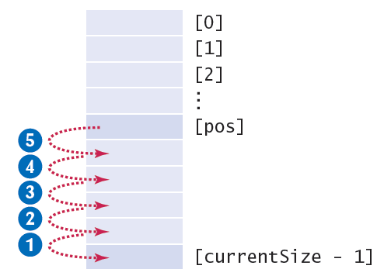
Common Algorithms 5:
Inserting an Element
Solution depends on if you have to maintain ‘order’
If not, just add it to the end and update the size
If so, find the right spot for the new element, move all of the valid elements after and including ‘pos’ down one spot, insert the new element, and update size
validate pos
IF currentSize < values.length
FOR i from currentSize-1 downto pos
move values[i] down one slot
ENDFOR
values[pos] = newElement
INCREMENT currentSize
ENDIF
Notes:
if (currentSize < values.length)
{
for (int i = currentSize - 1; i >= pos; i--)
{
values[i+1] = values[i]; // move down
}
values[pos] = newElement; // fill hole
currentSize++;
}

Slide 17
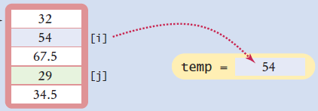
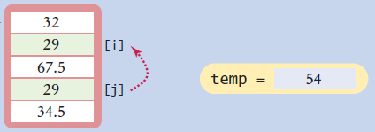
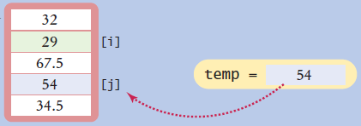
Common Algorithms 6:
Swapping Elements
Three steps using a temporary variable
double temp = values[i];
values[i] = values[j];
values[j] = temp;

Slide 18
18
We could write two versions of each algorithm
One version for the full array
Another version with an extra argument currentSize for a partially filled array
To simplify things, we will write just one version – the 2nd of the above
Then to call the method for the full array, just pass array.length as the value for currentSize
Notes:
See Arrays in java api for different methods for full/partially filled arrays.

